Slide 1
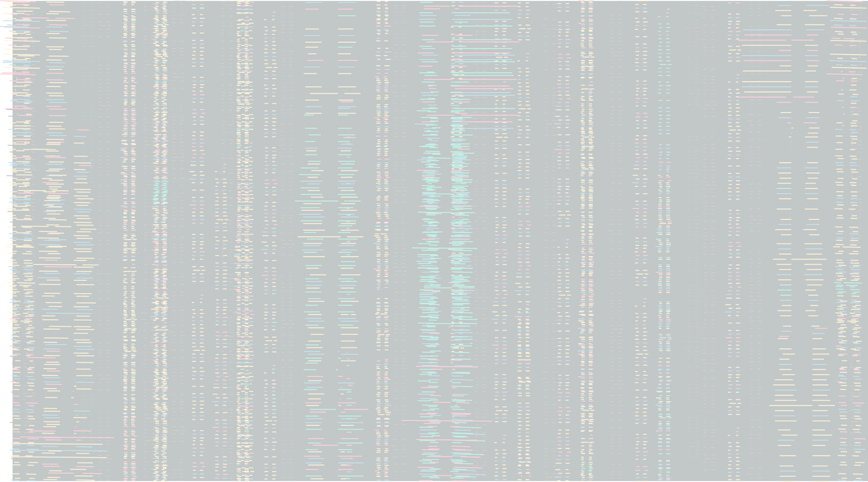


Personalized Nutrition:
Recommendation System Using Machine Learning
Python
Nikoloz Kordzakhia

Slide 2
What Is The Aim Of My Model
User Interaction:
Upon opening the app, the user is prompted to enter the date, meal type, and their specific nutritional goals for the day.
Recommendation Delivery:
The system outputs a list of meal recommendations directly on the user’s screen, displaying options that best meet their input criteria.
Each recommended meal includes comprehensive nutritional information, ensuring that users can see how each option aligns with their goals.

Slide 3

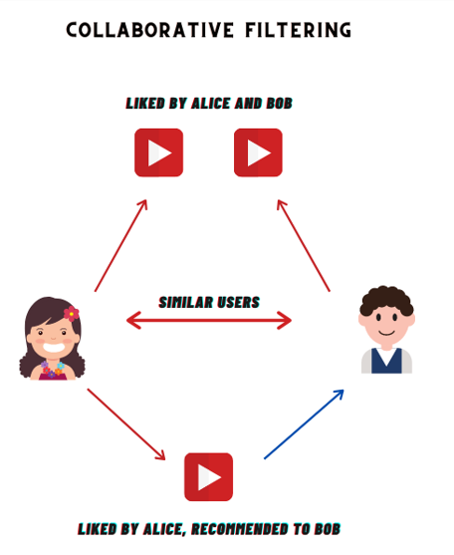
User-Based Collaboration Filtering

Slide 4


Input
Model Workflow
Day
Month
Year
Sequence
Meal_time
Is_snack
Is_drink
Is_supplement
Is_workout
Calories_goal
Carbs_goal
Fat_goal
Fiber_goal
Protein_goal
Sodium_goal
Sugar_goal
Similarity Calculation
Closest Matches Identification
Least Successful Match Identification
Dish Recommendation
Output
Recommended Dish(es)

Slide 5
Why Cosine Similarity
1
Directly measures how similar users are based on their feature vectors.
2
No need to pre-define clusters or determine an optimal number of clusters (k)
3
More effective in high-dimensional spaces as it focuses on the angle between vectors, making it less sensitive to the “curse of dimensionality
4
In PCA visualization, clusters were widely separated, making it challenging for k-means, but not for cosine similarity

Slide 6
Why Cosine Similarity
5
Works well even if clusters are not spherical or evenly sized
6
No need for additional steps to find the right cluster first, as in k-means
7
More effective in time and computations
8
Gives the application to be renewable more easier.

Slide 7
Cosine Similarity Limitations
1
Does not account for the actual shape or distribution of clusters, focusing only on vector direction.
2
Poor Performance with Large Variability in Vector Lengths

Slide 8
Why Not K-Means Algorithm
1
Assumes spherical clusters; struggles with non-spherical shapes
2
Difficulty in accurately positioning centroids for widely separated clusters.
3
Requires predefined number of clusters (k), which can be challenging to determine.
4
Leading additional step in model prediction.

Slide 9
Why Not DBSCAN Algorithm
Requires careful tuning of eps and min_samples; incorrect settings can lead to poor clustering.
1
2
Computational Complexity: High complexity can be inefficient for large datasets.
3
May classify many points as noise, leading to incomplete clustering.

Slide 10
Why Not Other Algorithms
Hierarchical Clustering
Why Not: Computationally expensive for large datasets; may not handle widely separated clusters well.
1
Gaussian Mixture Models (GMM)
Why Not: Assumes data follows a Gaussian distribution; can be sensitive to initial conditions and may struggle with clusters of different shapes.
2

Slide 11


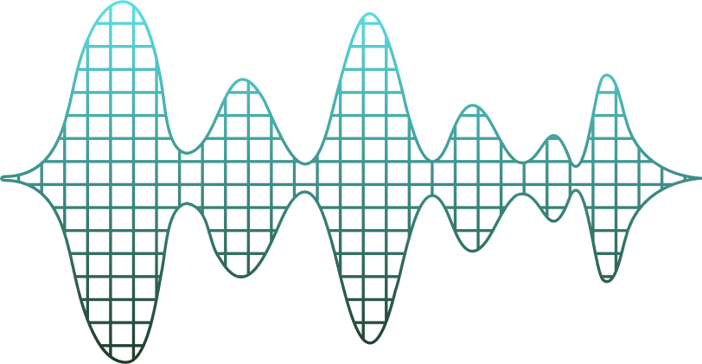
Thanks
I Hope You Enjoyed
— Any Questions?

